Slide 1


Green Pace
Security Policy Presentation
Developer: Jerrett Gonsalves

Slide 2

OVERVIEW: DEFENSE IN DEPTH
Protect against common code vulnerabilities
Educates our developers on the ways that code can be exploited
Suggests ways to detect code vulnerabilities using automation

Slide 3
THREATS MATRIX
The Threats Matrix provides a system for prioritizing potential security risks based on the severity of the exploited threat and likelihood it will occur
Likely Attacks that have a high severity and are more likely to be exploited | Priority Attacks that have the highest severity and could significantly impact the organization.
Low priority Attacks that have a high low severity, but aren’t unlikely to occur | Unlikely Attacks that have a low severity and are not likely to occur

Slide 4
10 PRINCIPLES
Validate Input Data (STD-001-CPP, STD-003-CPP, STD-004-CPP, STD-006-CPP, STD-010-CPP)
Heed Compiler Warnings (STD-006-CPP,
Architect and Design for Security Policies
Keep It Simple
Default Deny
Adhere to the Principle of Least Privilege
Sanitize Data Sent to Other Systems (STD-004-CPP, STD-006-CPP
Practice Defense in Depth (STD-003-CPP, STD-004-CPP, STD-005-CPP, STD-006-CPP, STD-007-CPP, STD-008-CPP, STD-009-CPP, STD-010-CPP)
Use Effective Quality Assurance (STD-002-CPP, STD-003-CPP, STD-005-CPP, STD-006-CPP, STD-007-CPP, STD-008-CPP, STD-009-CPP, STD-010-CPP)
Adopt a Secure Coding Standard (STD-001-CPP, STD-002-CPP, STD-003-CPP, STD-004-CPP, STD-005-CPP, STD-006-CPP, STD-007-CPP, STD-008-CPP, STD-009-CPP, STD-010-CPP)

Slide 5
CODING STANDARDS
STD-001-CPP: Do not rely on user inputted data to be of the correct type
STD-002-CPP: Avoid overflowing integers when performing mathematical operations on numeric data types
STD-003-CPP: Avoid Buffer Overflows by using std::string when gathering input
STD-004-CPP: Avoid SQL injection by sanitizing and/or parameterizing SQL statements
STD-005-CPP: Avoid memory leakage by deallocating memory created using the new keyword
STD-006-CPP: Do not leave assertions in production code
STD-007-CPP: Avoid unhandled exceptions
STD-008-CPP: Close files when they are no longer needed
STD-009-CPP: Ensure enough space for null-terminator in c-strings
STD-010-CPP: Ensure that division and remainder operations do not result in divide-by-zero errors

Slide 6
ENCRYPTION POLICIES
Encryption At Rest: Data not currently in use remains encrypted using Advanced Encryption Standard (AES)
Encryption in Flight: Data in transit is to remain encrypted using secure communication protocols SSL/TLS
Encryption in Use: Data being used must remain secure through restricting availability only to those who are authenticated and authorized

Slide 7
TRIPLE-A POLICIES
Authentication: Identifying actor accessing the system using credentials
Username, Passwords, Biometrics
Authorization: Granting permissions based on user role or user group
Default Deny
Accounting: Logging all system events for auditing and setting alerts for specific events
Successful/Unsuccessful login attempts
Accessing/Modification of files

Slide 8
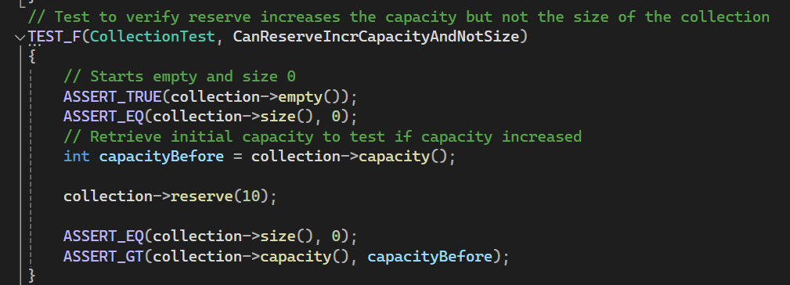
Unit Testing
Testing std::vector

Slide 9
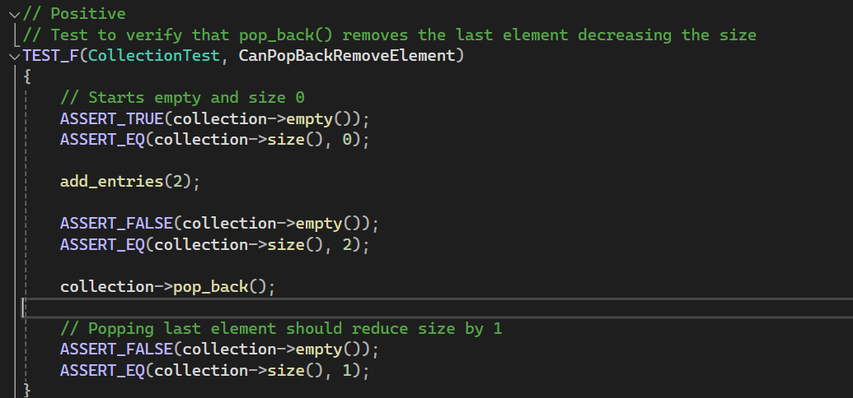
Unit Testing
Testing std::vector

Slide 10
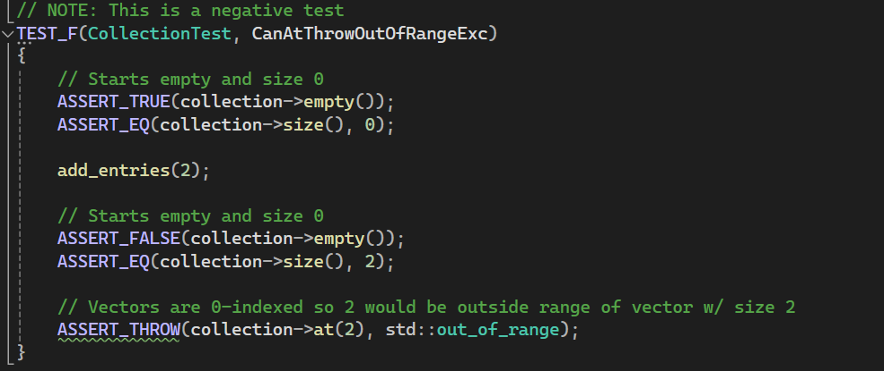
Unit Testing
Testing std::vector

Slide 11
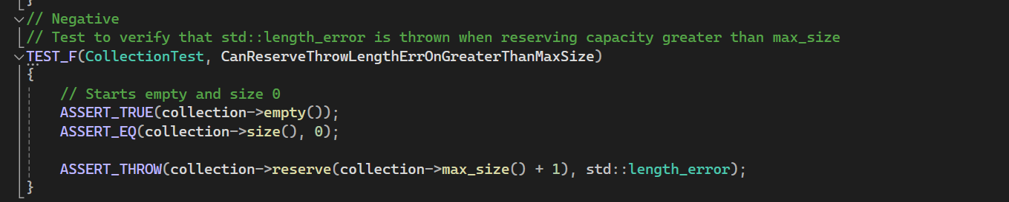
Unit Testing
Testing std::vector

Slide 12

AUTOMATION SUMMARY

Slide 13
TOOLS
Automate builds and tests in a CI/CD pipeline for cloud deployments (AWS CodeBuild, AWS CodePipeline)
Utilize tools such as CppCheck for detecting logical vulnerabilities
Monitor cloud deployments using AWS CloudWatch

Slide 14
RISKS AND BENEFITS
Problem: Current implementation does not have a standardized strategy for implementing security in new and maintained systems.
Solution: Create and implement a series of security standards and policies to be enforced in every stage of development including monitoring and maintaining systems
Downside: Incurs short-term costs to design, implement, and train employees on new standards of security
Benefits: Reduce vulnerabilities and instill trust in clients and user base

Slide 15
RECOMMENDATIONS
Verify security standards by creating effective penetration testing plans that occur on a regular basis
Provides verification that security standards are effective and allows for identification of vulnerabilities before malicious actors
Prevent exploitation of social engineering by providing regular training

Slide 16
CONCLUSIONS
Adopt a set of documented standards that employees adhere to prevent common security vulnerabilities
Verified adherence through reviews and automation tools
Update training regularly with information about latest news in security

Slide 17
REFERENCES
IBM. (2023). What is Social Engineering? | IBM. Www.ibm.com. https://www.ibm.com/topics/social-engineering
Yasar, K. (2021, May). What is pen testing? SearchSecurity. https://www.techtarget.com/searchsecurity/definition/penetration-testing

